Slide 1
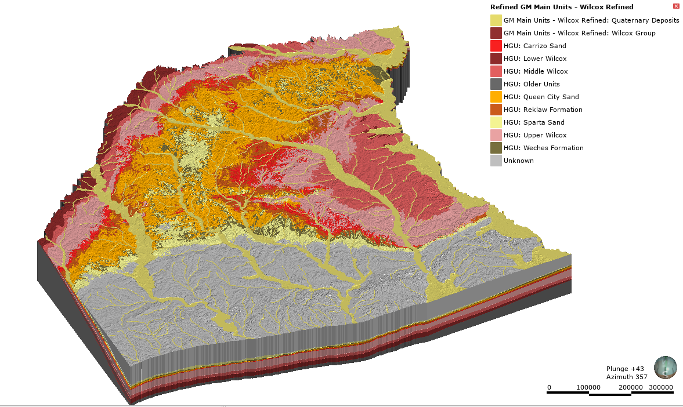
Application of MODFLOW 6 for groundwater availability modeling in Texas: Draft work in progress for Texas water development board
Sorab Panday
spanday@gsienv.com

Slide 2
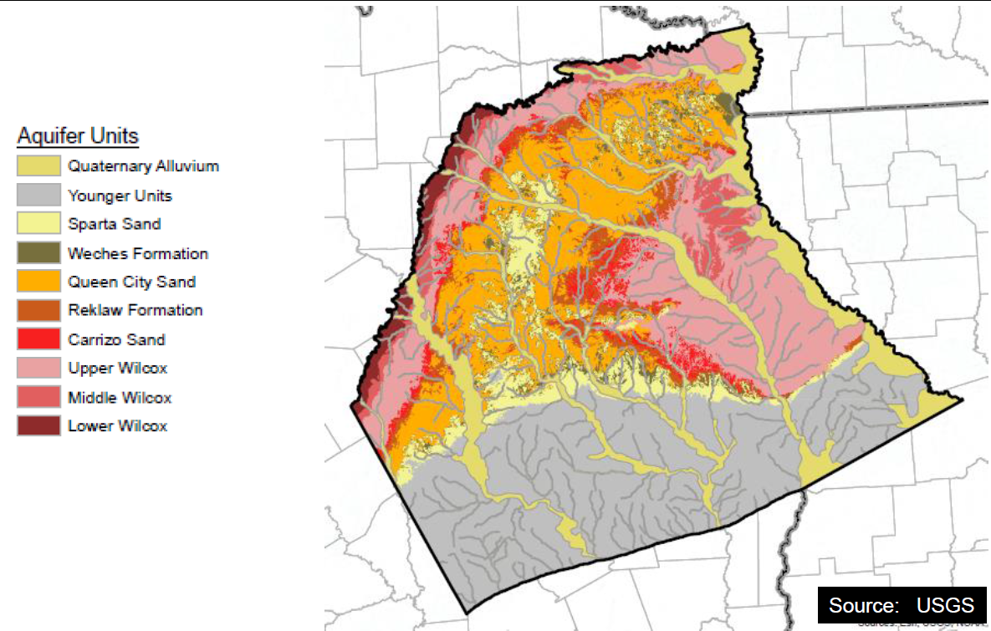
Model Domain
Represented as a GHB condition that exchanges water with Sparta Sand below

Slide 3
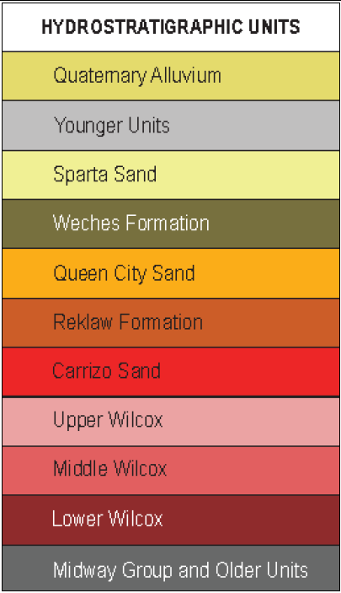
Model Layering
Represented as a GHB condition that exchanges water with Sparta Sand below
(Same conceptualization as in the October 2004 GAM for the Queen City and Sparta Aquifers).
Quaternary Deposits
Sparta
Weches
Queen City
Reklaw
Carrizo
Upper Wilcox
Middle Wilcox
Lower Wilcox

Slide 4
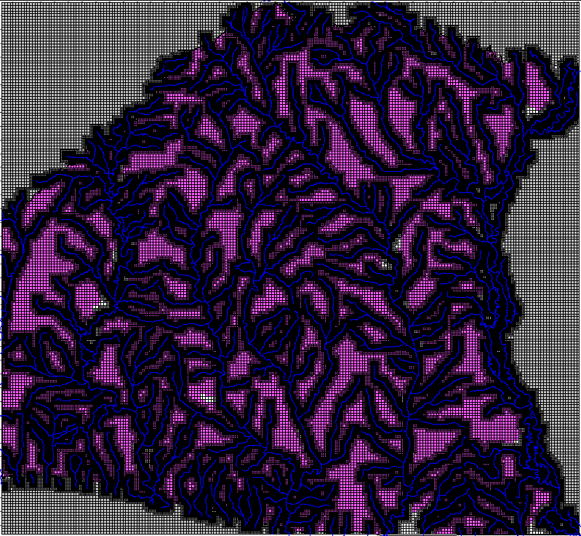
Model Gridding
Create Base Grid
185,505 total active cells
5,280 x 5,280 ft grid block size (1 mile by 1 mile)
Create quarter mile quadtree (QT) grid – maximum QT level 4
> 8 million active cells
660 x 660 ft minimum grid block size (1/8th mile by 1/8th mile)
Grid was over-discretized in lower layers
Solution – Create octree (OT) grid
GHB condition of Younger Units over Sparta Sands was applied after preliminary model runs

Slide 5
Final Model Grid Details
Base grid: NROWS = 193; NCOLS = 210; NLAY = 9
Maximum 1-mile grid size = 5280 feet
Oct-patch refinement along streams: Grid size = 660 feet
Grid coarsens with depth at active cells
Pinch-out layers less than 1 ft thick (0.3 ft limit set on conceptual model)
Pinch-outs, islands and pockets of the various units exist throughout the domain
Evaluate and pinch-out isolated pockets towards edge of model domain disconnected from boundaries
Number of active nodes: 637,536 .
Grid rotation of 29 degrees

Slide 6
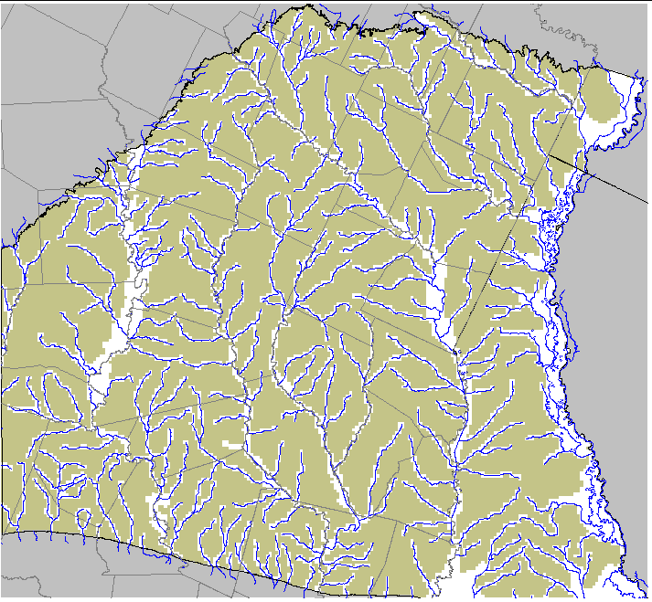
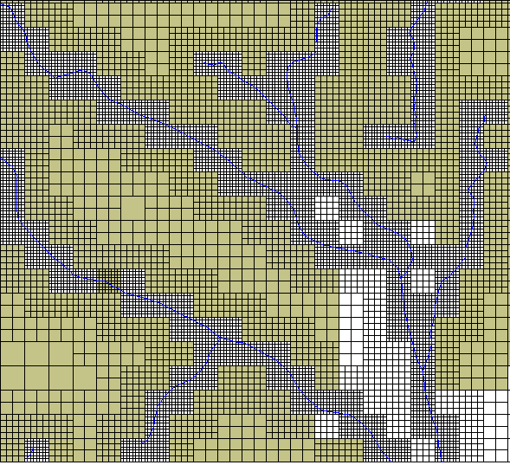
Grid Layer 1

Slide 7
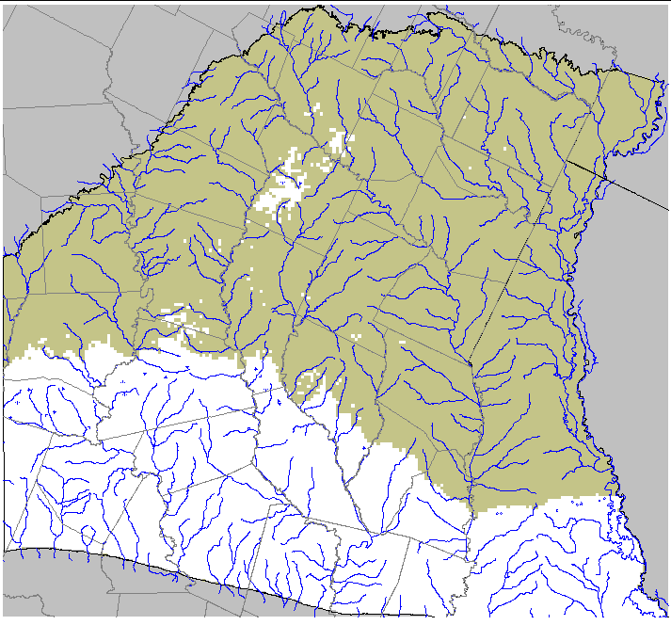
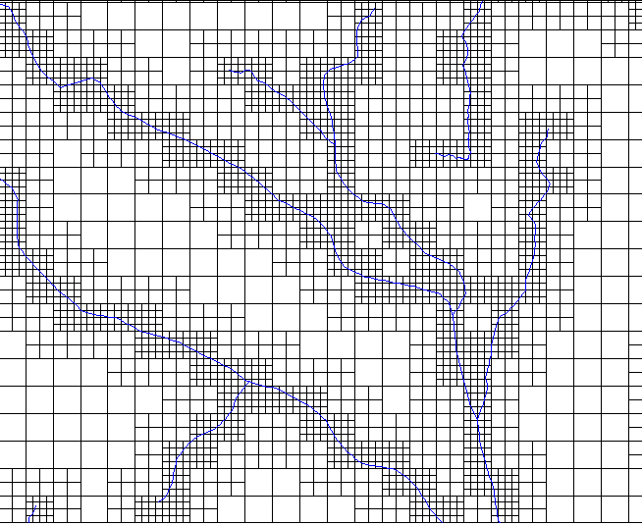
Grid Layer 2

Slide 8
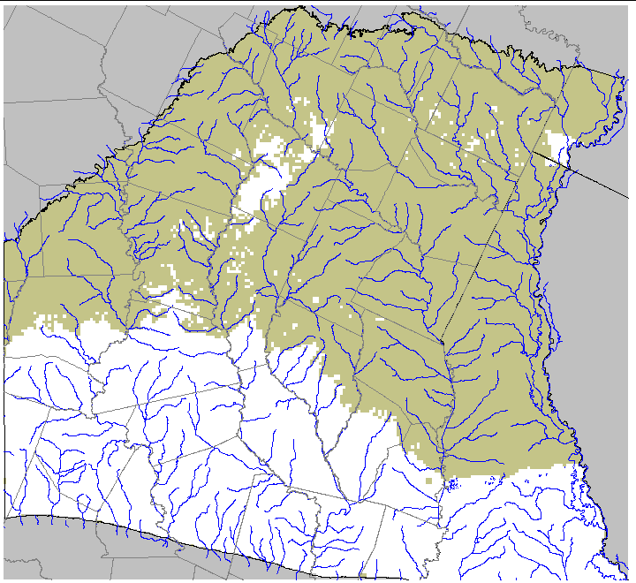
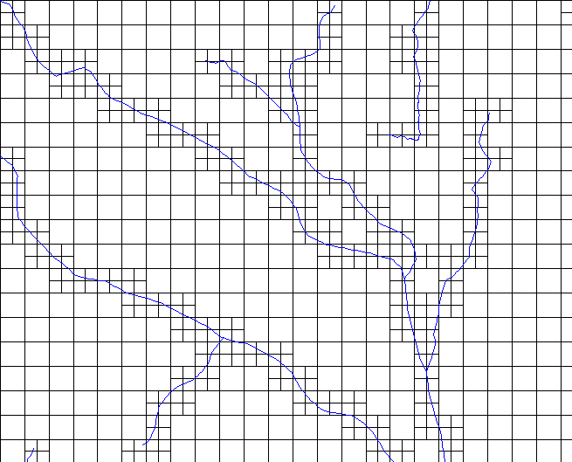
Grid Layer 3

Slide 9
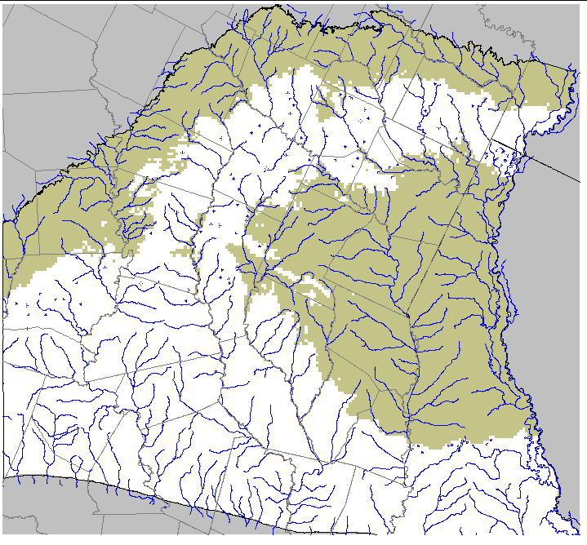
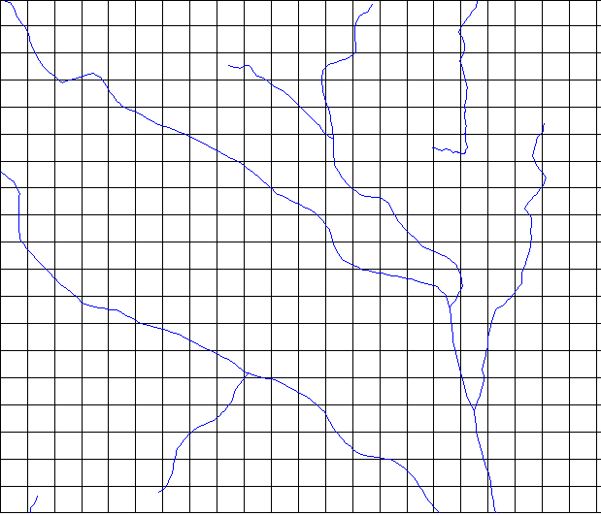
Grid Layer 4

Slide 10
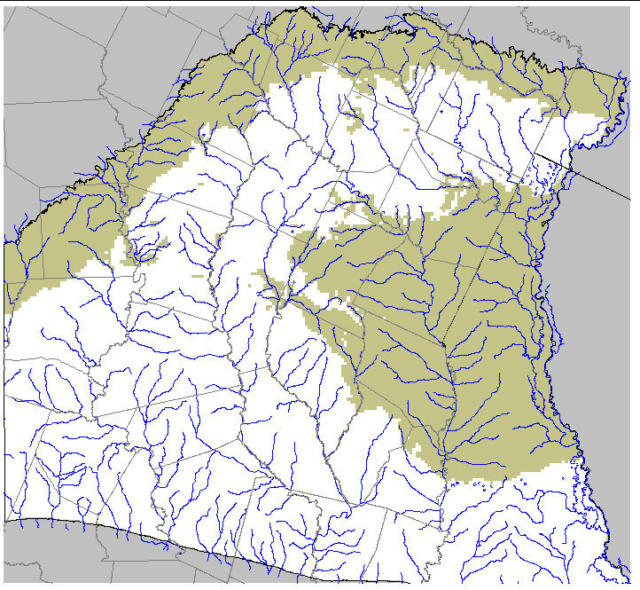
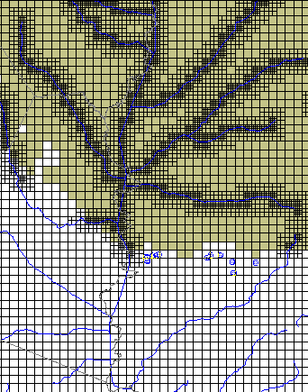
Grid Layer 5

Slide 11
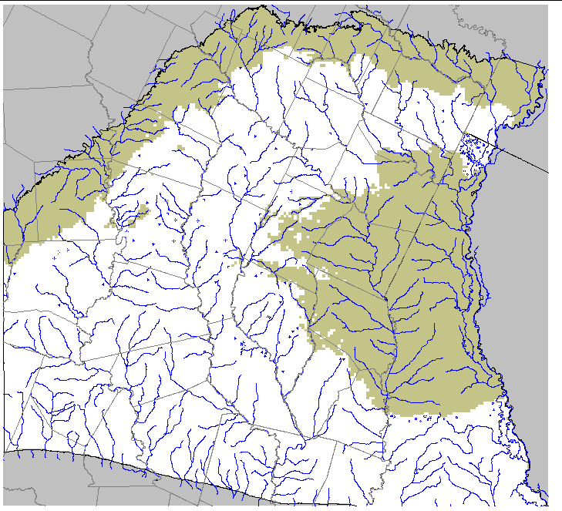
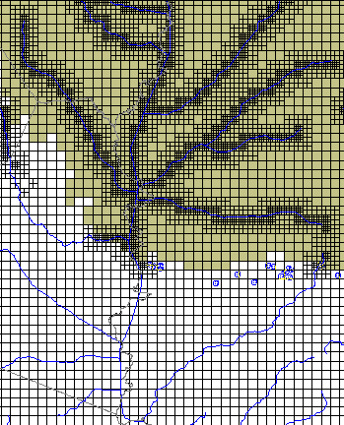
Grid Layer 6

Slide 12
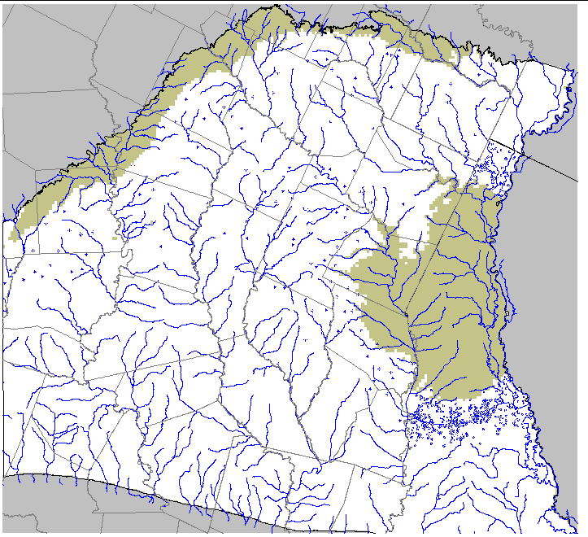
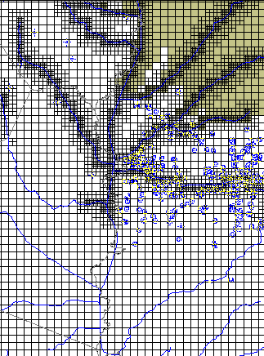
Grid Layer 7

Slide 13
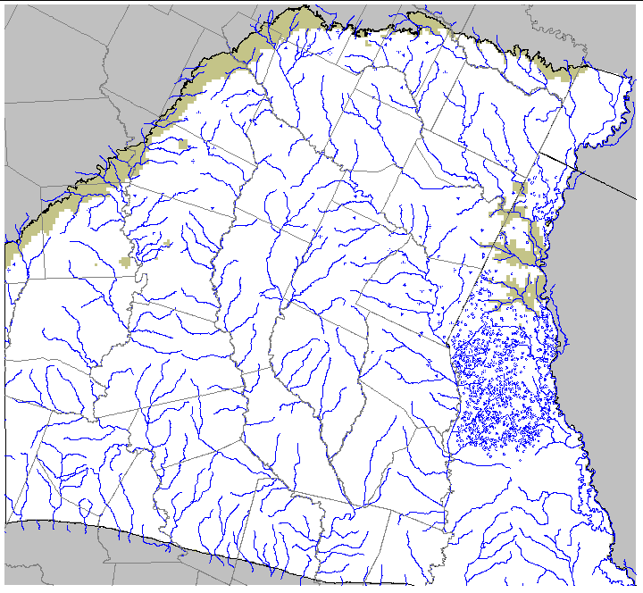
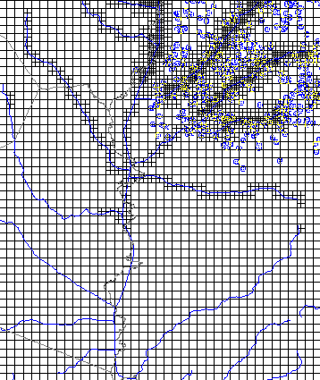
Grid Layer 8

Slide 14
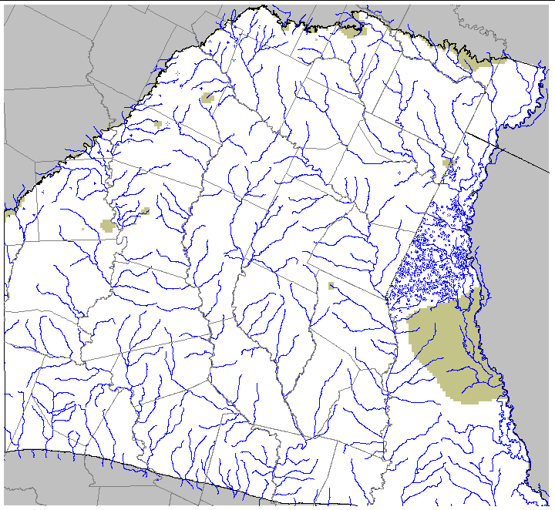
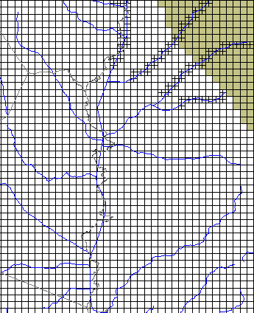
Grid Layer 9

Slide 15
Pinch-outs and Faults – Cross-section

Slide 16
Pinch-outs and Faults – Cross-section

Slide 17
Pinch-outs and Faults – Cross-section

Slide 18
Pinch-outs and Faults – Cross-section

Slide 19
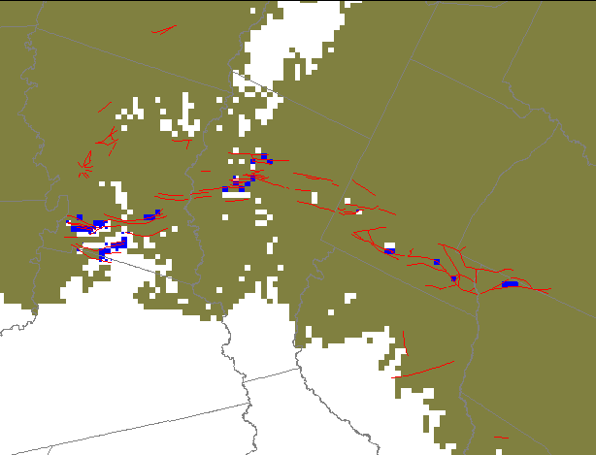
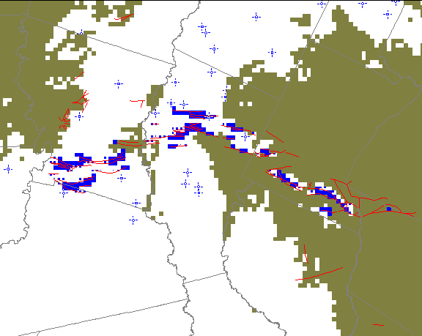
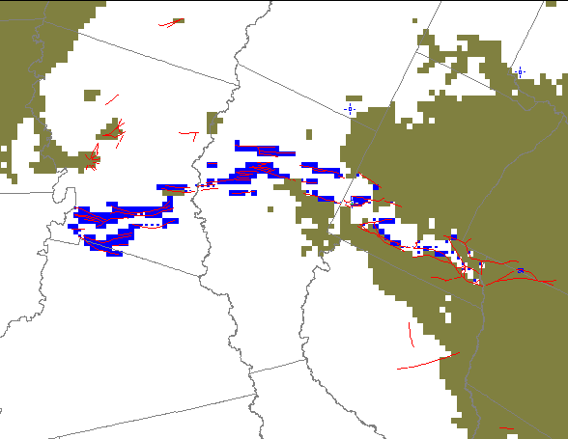
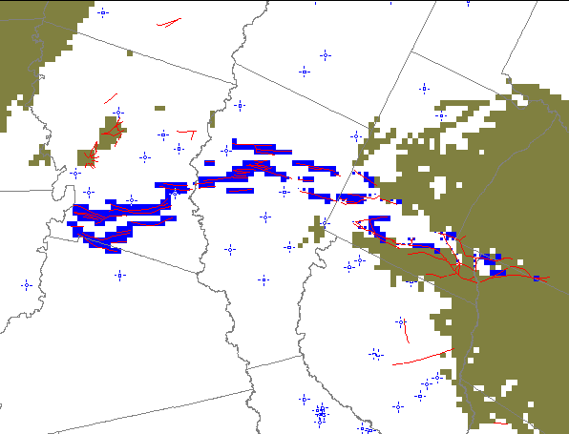
Layer Displacements
Weches (3), Queen City (4), Reklaw (5), and Carrizo (6) have cross-layer connections at faults
Layer elevations at fault location in conceptual model used to evaluate connectivity
Cross-layer connections of Weches
Cross-layer connections of Queen City
Cross-layer connections of Reklaw
Cross-layer connections of Carrizo
This amazing complex discretization was done by Groundwater Vistas (from ESI)

Slide 20
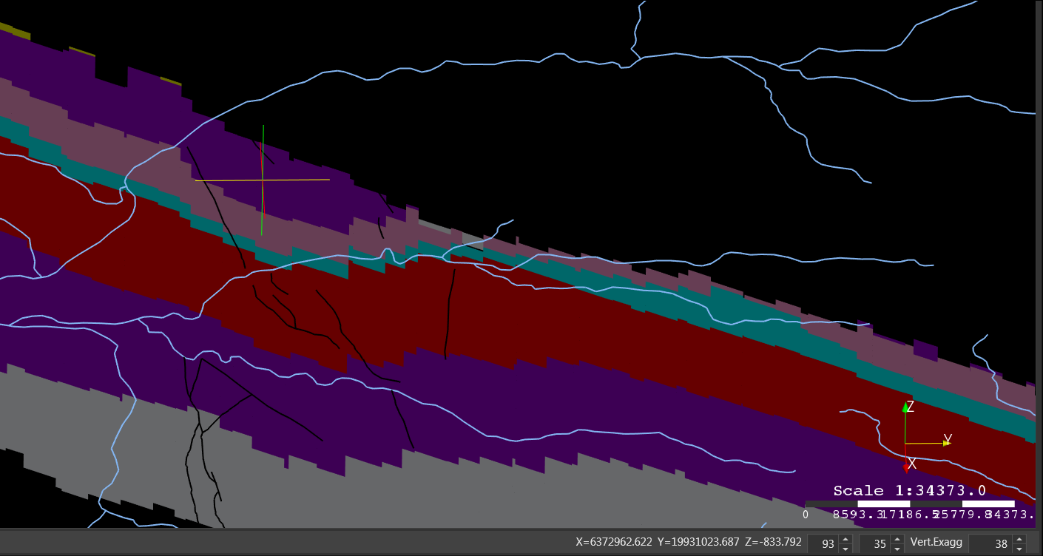
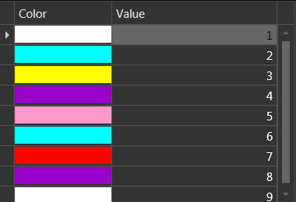
Slice through Enterprise Fault
Cross-connections

Slide 21
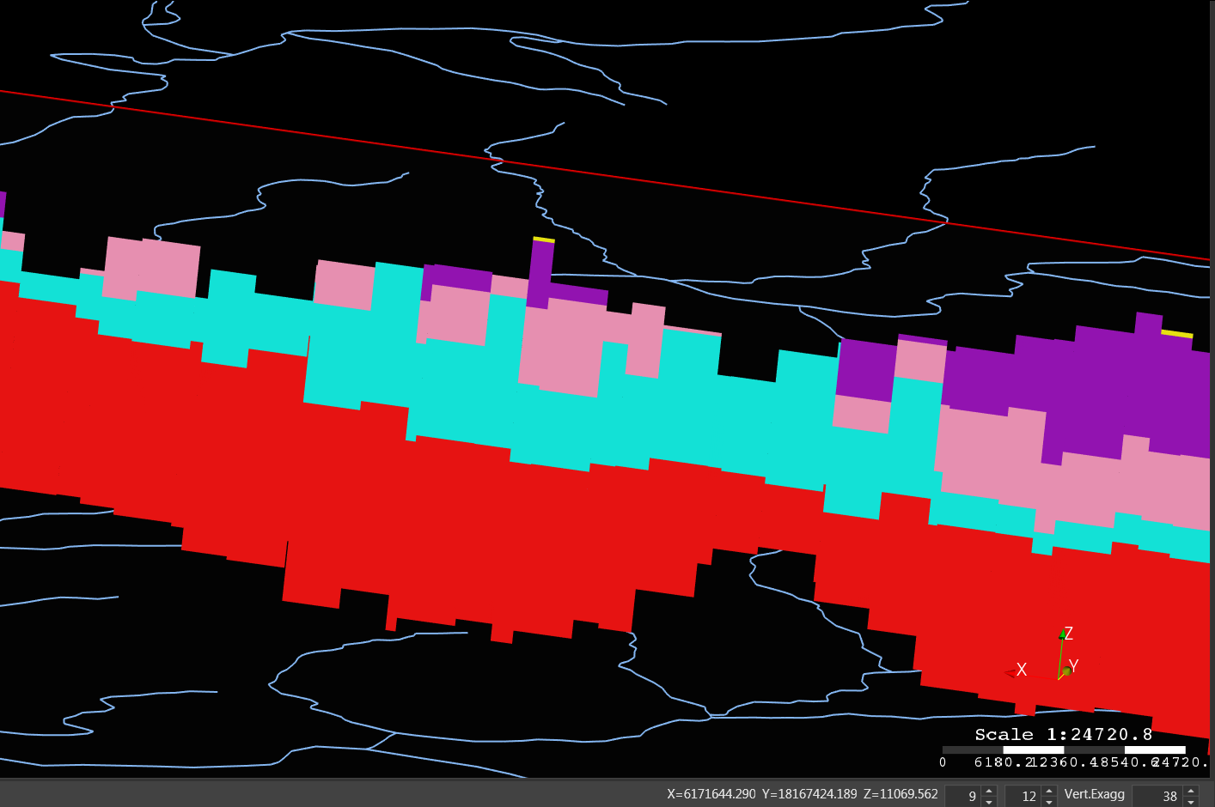
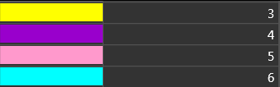
Slice through Enterprise Fault
Cross-connections

Slide 22
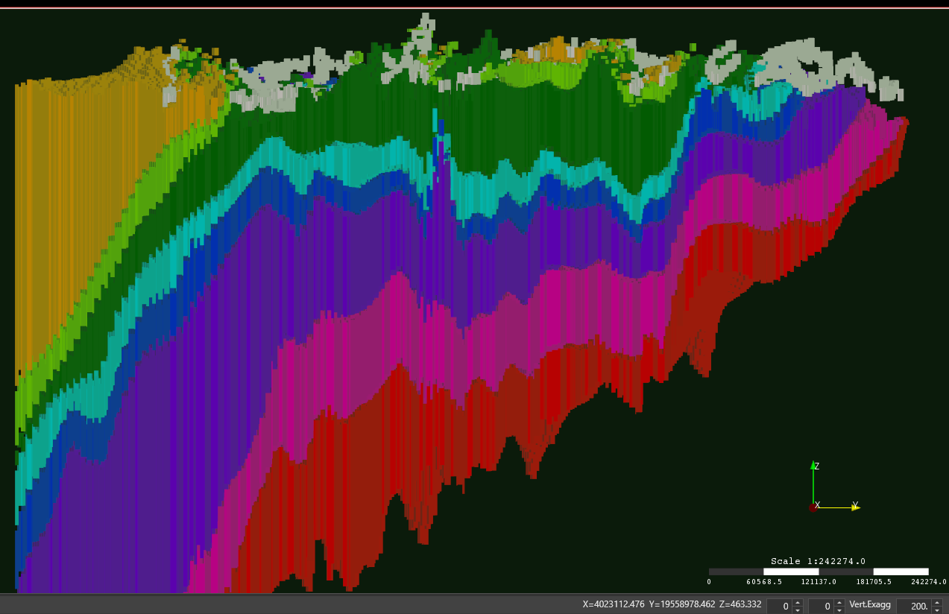
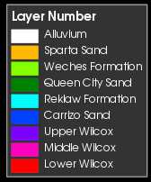
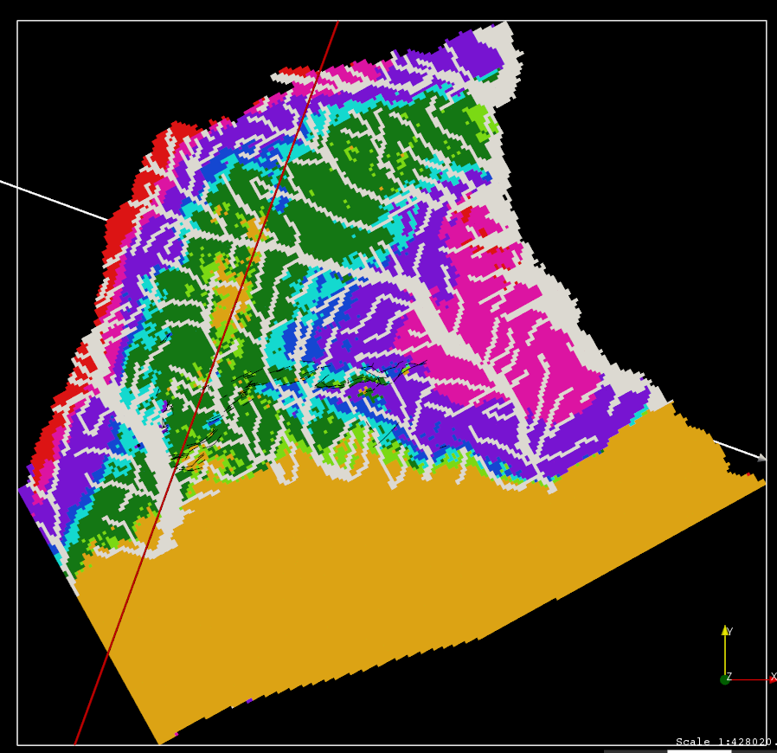
Slice through Enterprise Fault

Slide 23
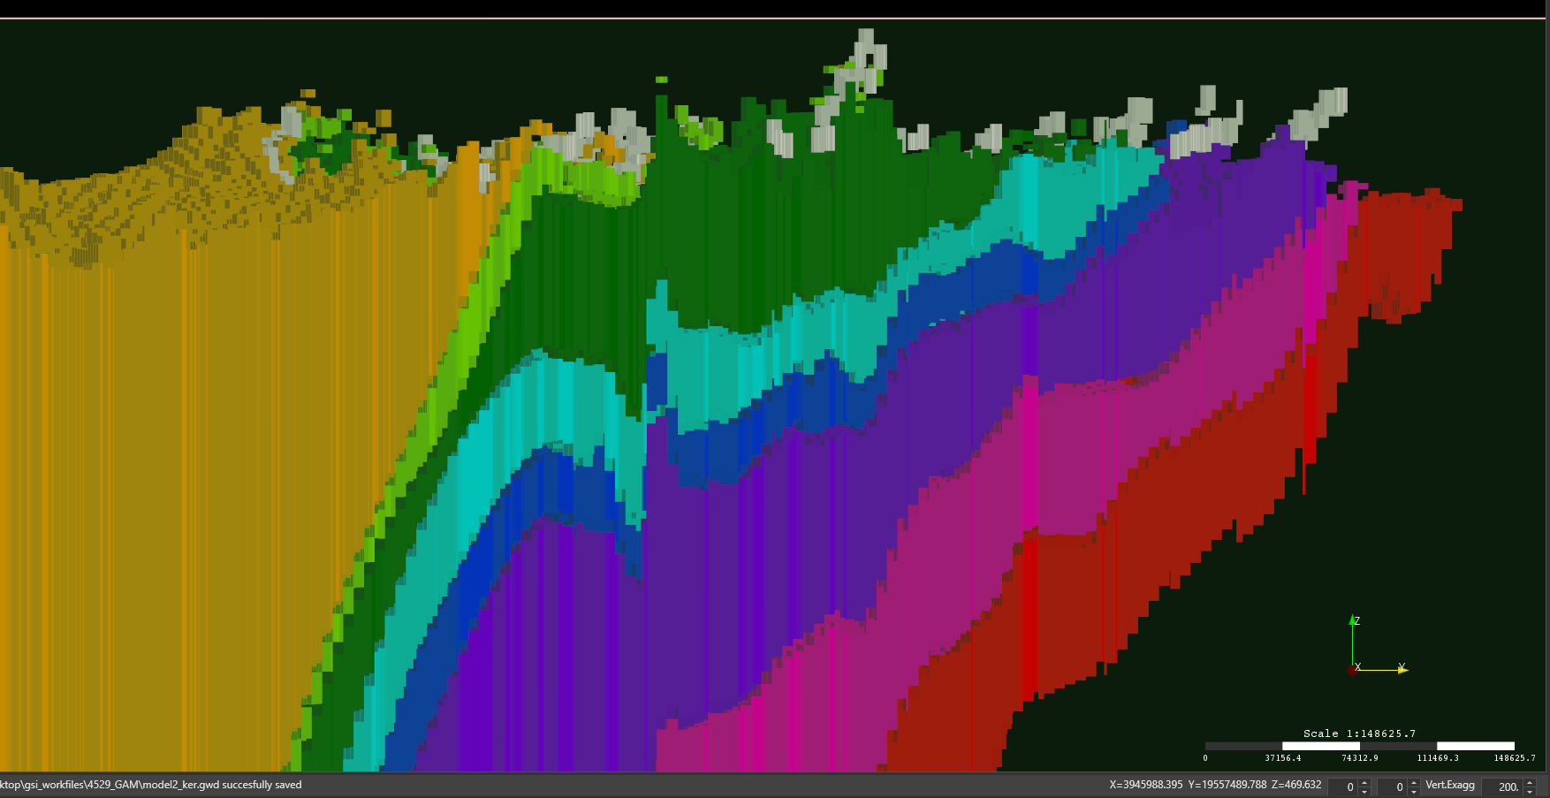
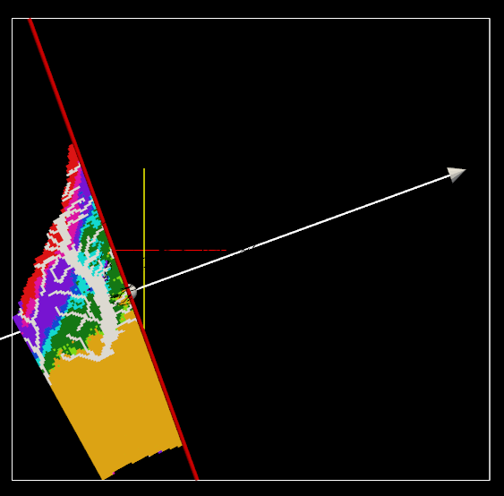
Slice through Enterprise Fault

Slide 24
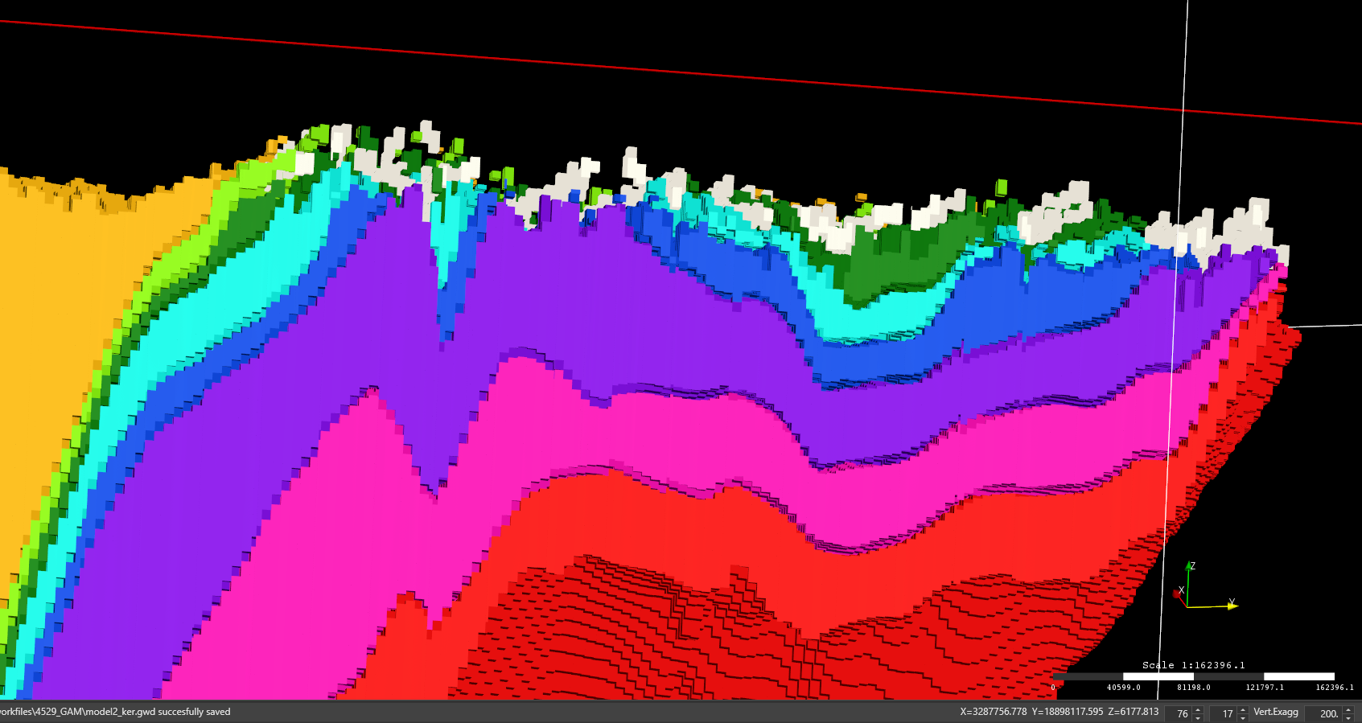
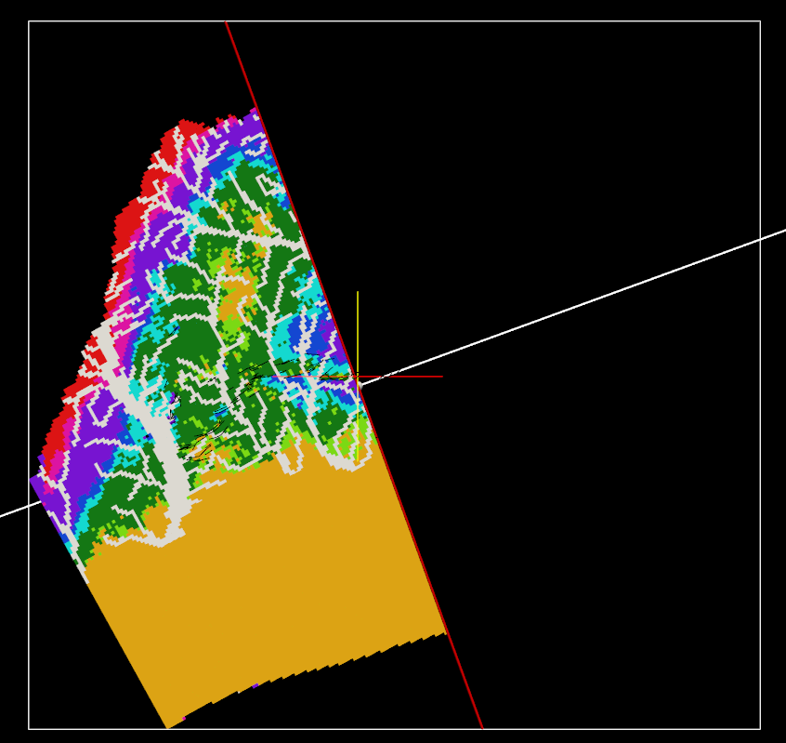
Slice through Enterprise Fault

Slide 25
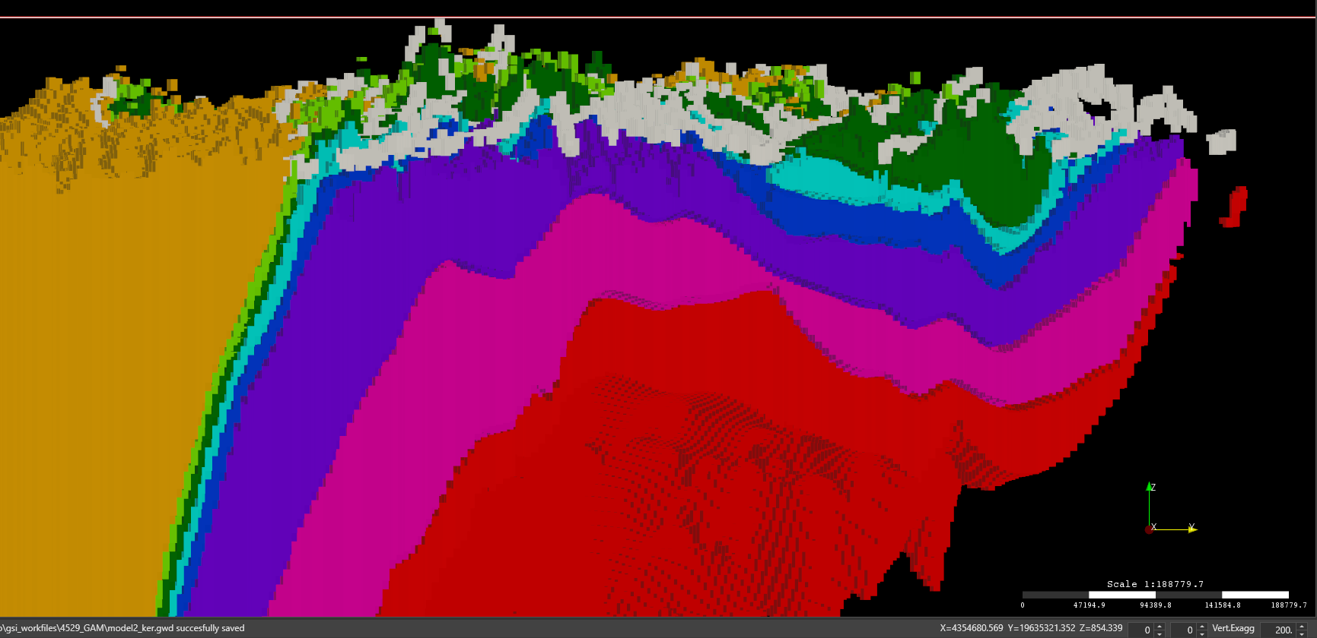
Slice through Enterprise Fault
These amazing images were produced by Groundwater Desktop Version 3 (from SSPA)

Slide 26
Model Parameterization – Observed K-value Averages
Unit K-values [ft/d];
Quaternary Deposits: 15.0;
Sparta: 14.3;
Weches: 0.1;
Queen City: 4.8 ;
Reklaw: 0.1;
Carrizo: 5.6;
Upper Wilcox: 3.8;
Middle Wilcox: 3.6;
Lower Wilcox: 2.7;
Kh estimated for aquitard units
Available sand fraction data may be used for parameterization
Use weighted arithmetic mean of K-values for horizontal
Use weighted harmonic mean of K-values for vertical
Preprocessing computed grid-cell K-values from input K-values for sand and non-sand material directly through Groundwater Vistas

Slide 27
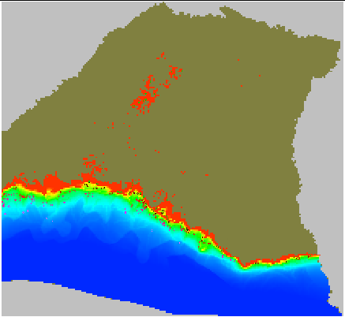
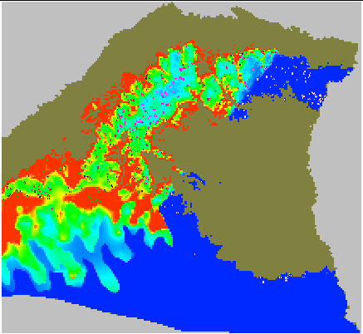
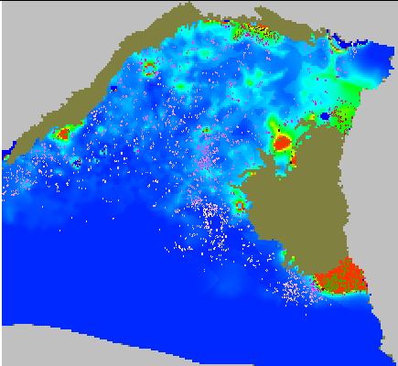
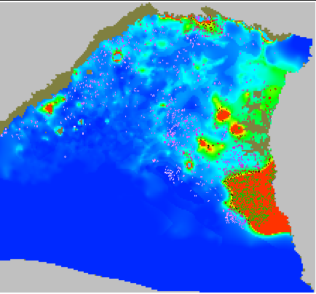
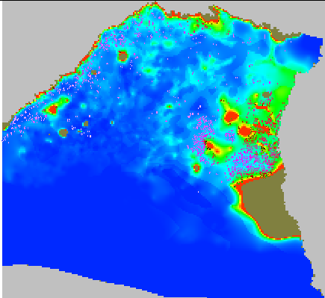
Sand Fractions (0.05 blue to 0.95 red)
Alluvium Layer 1: 0.7 Sand
Reklaw Layer 5: 0.1 Sand
Weches Layer 3: 0.1 Sand
Sparta Layer 2
Queen City Layer 4
Carrizo Layer 6: 0.7 Sand
Upper Wilcox Layer 7
Middle Wilcox Layer 8
Lower Wilcox: Layer 9

Slide 28
Steady-State and transient Targets
Layer | Unit | # of SS Targets | # of Transient Target Locations
1 | Quaternary Deposits: | 5 | 5
2 | Sparta: | 21 | 45
3 | Weches: | 0 | 0
4 | Queen City: | 40 | 194
5 | Reklaw: | 6 | 6
6 | Carrizo: | 40 | 336
7 | Upper Wilcox: | 40 | 474
8 | Middle Wilcox: | 40 | 581
9 | Lower Wilcox: | 40 | 340
Total of 232 steady-state target locations
Total of 1,981 transient target locations
Total of 21,533 transient target values from 1980 through 2014
Reklaw targets are probably monitoring the Queen City aquifer unit

Slide 29
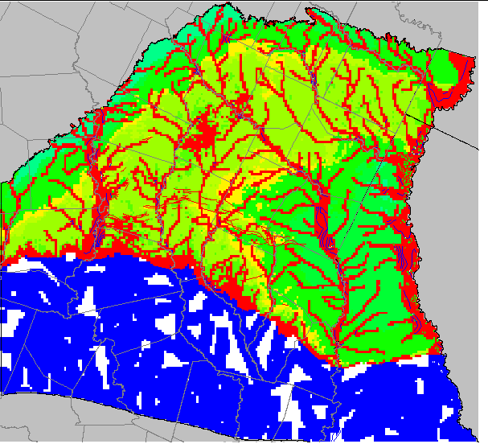
Recharge rates for MODFLOW 6 with octree grids
Recharge from precipitation occurs in outcrop areas
Recharge is a function of the hydraulic conductivity value of the outcrop areas
MODFLOW 6 removes layers above the outcrop (instead of using inactive cells) requiring additional rate recalculation with octree connections depending on preprocessing strategies
Estimates of 640,000 af/y (7.638 E7 cu-ft/d) for 1980

Slide 30
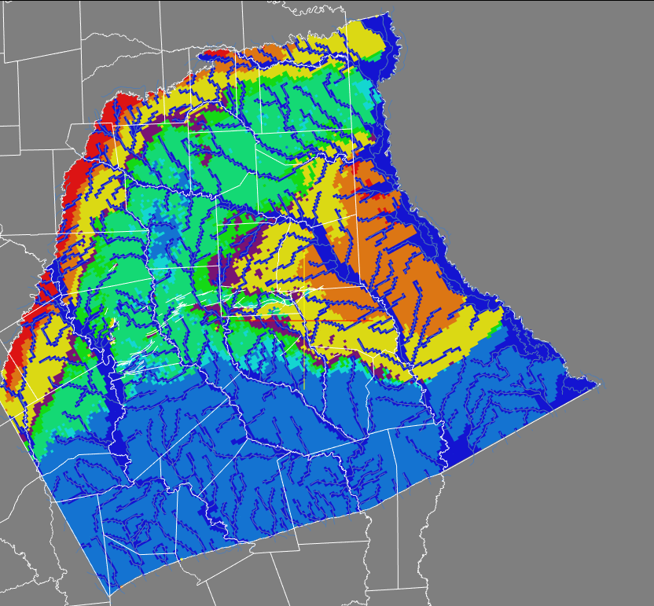
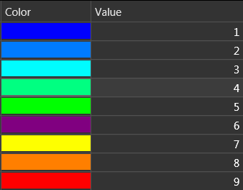
Formation Outcrops with Carrizo Outcrop highlighted
Carrizo

Slide 31
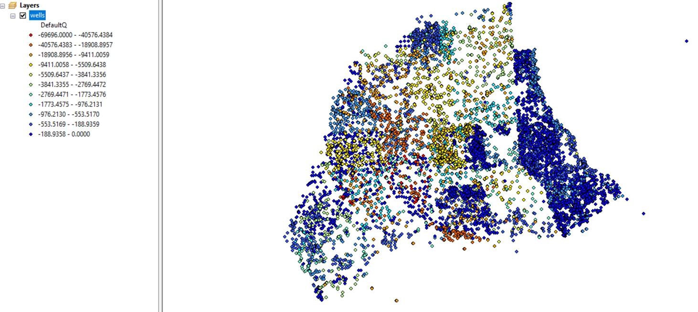
1980 (Steady-State model) Well Pumping

Slide 32
Preliminary Steady-State Simulation with Average Parameter Values
Most targets are in the upper reaches of each layer
Layers 4 through 9: Have very similar simulated WLE contours
Need more isolation (lower Kv) among layers
Lowering K of Clay lowers Kv among layers (Harmonic mean is closer to low value)
Layers 4 and 5: Need to raise WLEs
Lower K of Clay in layers 4 and 5
Lower Kh will also prevent loss of flow from recharge areas
Layers 6-8: Need to raise high WLEs and lower low WLEs
High WLEs are in recharge areas to north and low WLEs are in discharge areas to south
Lower Kv will prevent loss of recharge and excess discharge helping with all WLEs
Lower Kh will also prevent loss of flow from recharge areas to discharge areas
Layer 6: Need larger cone of depression at Paper Mill Well area
Allow less water into Layer 6 and less lateral flow towards the well
All indicators point to lowering K of clay in layers 4-8 as a first step
Helps to lower K of clay
PEST on steady-state model
This amazingly complex simulation was conducted with MODFLOW 6 (from USGS)

Slide 33
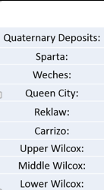
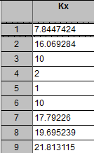
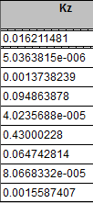


PEST Results – Parameters and Calibration Statistics
Parameter Values
Statistics
Regression
K-Values (ft/d) are reasonable
Similar statistics to previous PEST runs
Generally good fit to data
Better matches low WLEs in layers 6 and 7

Slide 34








Layer-wise Regression and Water Budgets
Cu-ft/day | IN | OUT
WEL | 0 | 29,576,156
GHB | 7,032,000 | 7,370,466
RCH | 76,338,498 | 0
EVT | 0 | 25,176,562
SFR | 34,77,316 | 24,724,771
Total | 86,847,815 | 86,847,954
Generally good fit to data in all layers
Water budget terms look reasonable
Largest inflow is recharge
Largest outflows are from WEL, EVT, and SFR.

Slide 35








Water Levels
Layer 2
Layer 4
Layer 6
Layer 9
Simulated WLEs are generally ok; patterns are not reproduced well
General WLE contours are simulated;
Cone of depression in Carrizo is simulated
Pattern reproduced;
Regression fit is good
Mimics layers 4 & 6

Slide 36
Issues / Hurdles and Solutions / Work-arounds
Pseudo-Transient Convergence (PTC) for steady-state simulations in MF6
Slows down “convergence” when initial heads are at or near the solution
Use NO_PTC option to turn it off
Outer (nonlinear) iterations continue past tolerance limit
Impacted by other checks on SFR iterations, as well as inner iterations
Need to balance these tolerances for smoother convergence
Cold starts on SFR
Restarts do not return in 1 iteration (takes 50 or more iterations)
Use stream water levels from an SFR run as heads using the RIV package
Intermittently check / update these water levels during calibration and for final model

Slide 37
SFR issues
SFR runs 10 to 20 times slower
SFR SIMPLE option using resulting heads gives different results altogether
Convert back to RIV and use resulting stages as RIV boundary head
Gives same result as SFR
Convert steady and transient models to RIV using SFR solution as boundary head
SFR cold-start issues are not new to MODFLOW 6
LNF model will use latest solution to restart a simulation

Slide 38
What was Awesome
Complex octree grid with pinch-outs and cross-connections was easily handled
IMS solvers (linear and nonlinear) are stable and robust even with all the flow complexities
Solutions were obtained with wrong parameters / geometries / connectivities when model was being developed enabling easier trapping of errors
Nonlinear solver did not perform too much backtracking indicating functional smoothness
Linear solver did not require excessive levels of fill indicating robust performance
Good for PEST simulations where model failure or excessive computation time are detrimental to the calibration process
Listing provides good information to trap errors and observe and tune solution performance
QA of files was so much easier with keyword inputs replacing flags

Slide 39
Runtime statistics
Steady-state simulation of 1980 conditions
With RIV package = 1.25 minutes
With SFR package = 22 minutes
Transient 34 year simulation with annual stress periods
With RIV package = 56 minutes
With SFR package = 6 hours 25 minutes
Simulation with required resolution would not be feasible with standard finite-difference MODFLOW grids
Preliminary simulations with MODFLOW-USG
NaN issues in XMD solver
Poor convergence with PCGU solver
Returned with the same solution as for MODFLOW 6 run when started with MODFLOW 6 solution

Slide 40


Preliminary Transient Model Results
Statistics – transient
Regression
Transient statistics:
RMS is twice as worse as steady-state
Sum of squares increased by factor of 100
Generally poor fit to data
Flattening of lower WLES noted

Slide 41








Layer-wise Transient Regression
Layers 1, 2 and 3 are fine. Probably topography controlled
Layer 4 has very poor match
Modeled generally larger than observed
Horizontal patches probably indicate observed fluctuations with not too much simulated fluctuations
Layers 6-9 have poor match
Target values are generally bunched though they do follow the regression line

Slide 42







Some quick hydrographs
Outlier

Slide 43
Water budgets
GW-Chart is updating to MODFLOW 6
Used Zonebudget 6 with just one zone to extract water budget terms from the model

Slide 44
Water Balance Terms (Rate)
The largest inflow term is recharge from rainfall
Recharge is approximately equally distributed to:
WEL-OUT
EVT-OUT
GHB-OUT

Slide 45
Water Balance Terms (Cumulative)
Largest cumulative inflow is recharge
Outflows: EVT > RIV > WEL > GHB > Sy (head drop)

Slide 46
Model Status
Model has been developed
Calibration is ongoing
Currently a draft work in progress for Texas Water Development Board
Thanks to TWDB for allowing us to present this draft work in progress

Slide 47
Questions
??
spanday@gsienv.com

